Slide 1
An Overview of research Groups and Centres in the School of Psychology
Amanda Roberts, Hannah Merdian, Bonaventura Majolo
College of Social Science Annual Research Showcase: July 20th 2022

Slide 2
Introduction
Overview:
Research Groups:
Forensic and Crime Research Group;
Cognitive Psychology Research Group;
Psychological Health & Wellbeing (PheW);
Development and Behaviour Research Group;
Social Psychology Research Group.
Research Centres:
Autism Research Innovation Centre;
Lincoln Sleep Research Centre.
Impact: REF and beyond.

Slide 3
RESEARCH Groups in the school of psychology
Forensic and Crime Research Group, Cognitive Psychology Research Group, Psychological Health and Wellbeing, Development and Behaviour Research Group & Social Psychology Research Group.

Slide 4
Forensic and Crime Research Group
Ross Bartels & Georgina Gous
Attitudinal Research
Investigative and Courtroom
Gambling and Addiction
Understanding Offending
Forensic Practice
Service Evaluation

Slide 5
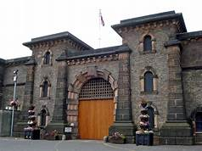
Forensic and Crime Research Group
Research Funding Awards:
ESRC Funded Project: Rachael Dagnall.
The impact of introducing and easing restrictions during
the covid-19 pandemic.
NIHR CRN East Midlands: £39,890.84. Amanda Roberts. “Mapping and Understanding Gambling Related-Harm in Lincolnshire”.
Funding Awarded: £60,000. Todd Hogue, Lauren Smith, Rachael Mason & Niko Kargas. “Independent Review of Services for Adults with a Learning Disability and Autistic Adults in Midland’s prisons”.

Slide 6
Cognitive Psychology Research Group
Kun Guo & Julia Föecker
Way humans perceive, make sense of, and respond to natural and social surroundings.
Vision, attention, memory, emotion, reasoning, sleep, language & motor control.
Psychophysics, neuropsychological testing, mobile and laboratory- based eye-tracking, brain imaging (EEG, fNIRS), brain stimulation (TMS, tDCS).

Slide 7
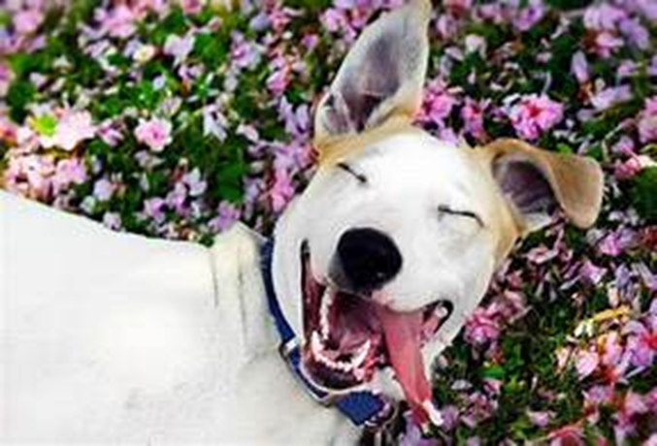
Cognitive Psychology Research Group
Example Areas of interest:
The Lincoln Face Lab: face perception and face recognition (Tessa Flack, Robin Kramer & Kay Ritchie).
The use of colour in visual art (George Mather).
How technologies can be used to improve sensory and cognitive functions across developmental stages (Julia Föecker).
Understanding each other’s emotion in human-dog interaction (Kun Guo).
Cognitive Daisy to support person-centred care in the community and in residential care (Petra Pollux).

Slide 8
Psychological Health & Wellbeing (PHeW)
Dave Dawson & Nima Moghaddam
Applying psychological theory and understanding to address health and wellbeing.
Conducting practical research, focused on building knowledge to inform practice.
Much of the group’s work involves partnership with local services and stakeholders.
E.g., Research Development Forum with Lincolnshire Partnership NHS Foundation Trust.
25+ members (and growing!).
Many are involved in professional training and practice.
Across career stages, from PGRs to Professorial.

Slide 9
Psychological Health & Wellbeing
Current research projects and interests:
Multiple NIHR-funded research programmes: common focus on developing and improving care provisions, to support health and wellbeing:
TheRapeutic Interactions in Psychological therapy Of anxiety and Depressive disorders (TRIPOD).
SMART MS and SMART MCI.
Group foci map to UK mental health research agenda 2020-30: w/members researching mental health for children & young people (goal 1), links between physical & mental health (goal 2), development of new interventions for mental health (goal 3) and improving choice & decision-making in routine care settings (goal 4).

Slide 10
Research group Development and Behaviour
Research areas
Developmental Psychology
Behaviour and Evolution
Human-animal interaction
Interventions
Decision-making
Motivation and Memory
Neurodevelopmental disorders
Injury Prevention
Epidemiological research
Research funding
ESRC
NIH
NIHR
Leakey Foundation
Waltham Foundation
Waltham Petcare Science Institute
Malaysian Ministry for Higher Education
American Association of Physical Anthropology

Slide 11
Research group Development and Behaviour
Interdisciplinary team
of developmental, social and evolutionary psychologists
United Nations' 2030 Agenda for Sustainable Development
University Research themes
Our participants in the field and in the lab
Infants, children, adolescents, adults
- neurotypical and/or with special educational needs
Monkeys, Dogs, Fish, Swans
Research centre
Autism Research Innovation Centre
Impact Case study 2021
The Barbary Macaque Project: Applying Psychology to
Animal Conservation
13 Staff members, 11 PhD students, Research group Lead: Prof Kerstin Meints, Deputy Lead: Dr Valentina Sclafani, 1 Visiting Professor - Dr Sandra McCune

Slide 12
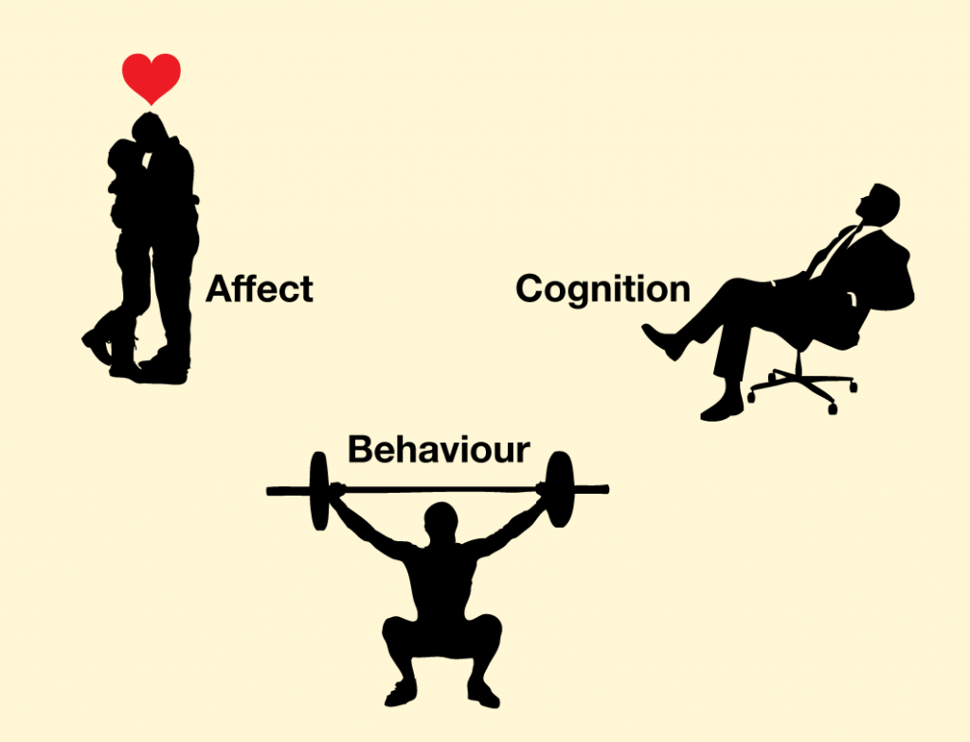
Social Psychology Research Group:
Ruth Gaunt & Nathan Heflick
Gender norms, ambivalent sexism, menopause across cultures
Sexual objectification, definitions of sexual behaviour
Body image, attractiveness, eating disorders
Music listening and emotion regulation.
The impact of COVID-19 on cognition and behaviour (Nathan Heflick). Coronavirus related to worse short-term memory; pandemic increased social anxiety and short-term behaviours aimed at improving mood.
The effects of media on children's body perceptions and body ideals (Tracey Thornborrow). Consequences of media exposure, in collaboration with Durham University, Spain, Argentina, and Colombia.

Slide 13
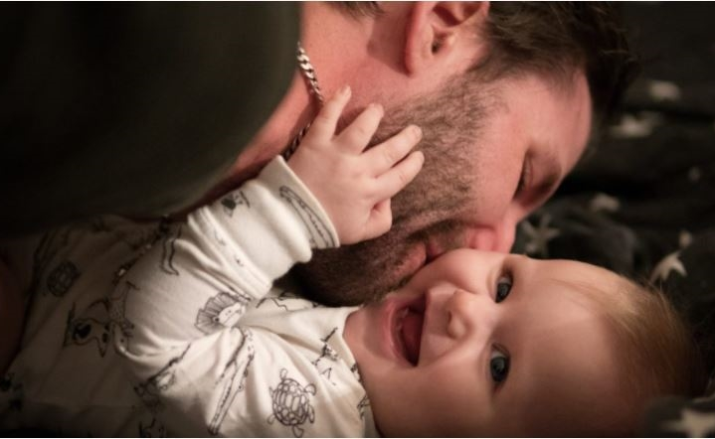
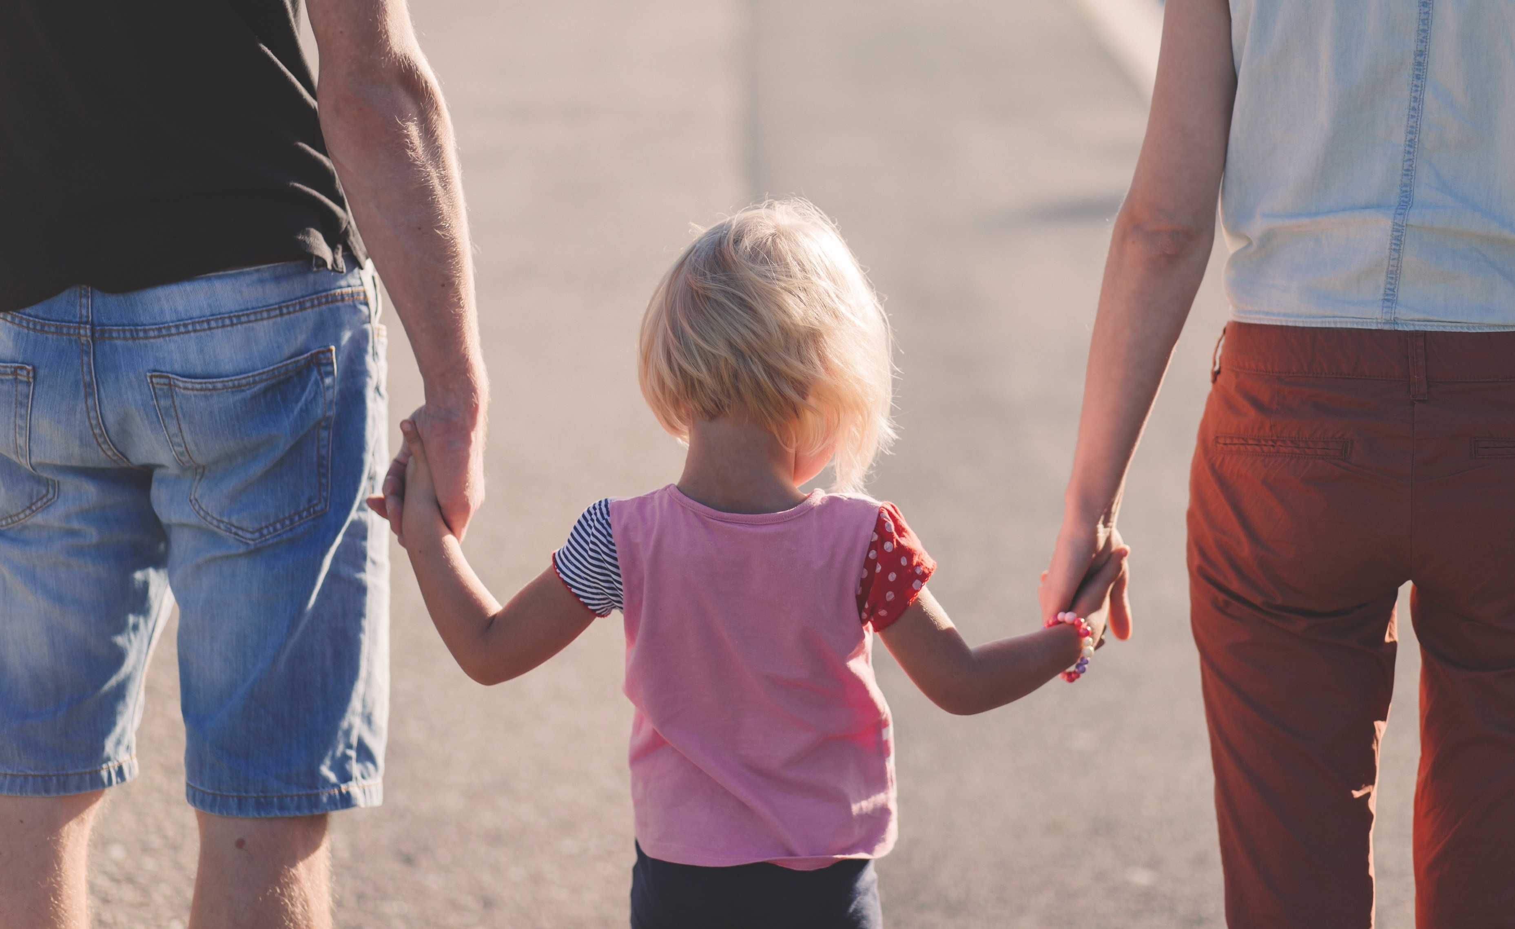
Social Psychology Research Group
Caregiving dads, breadwinning mums: Transforming gender in work and childcare:
Ruth Gaunt & Ana Jordan (£173,510)
3-year mixed-methods project: Nuffield Foundation.
Compares couples who share childcare equally, couples who reverse roles & traditional couples.
Routes and barriers to greater gender equality and highlight policy changes.
Public report will be launched in a webinar hosted by the Women’s Budget Group in September.

Slide 14
RESEARCH CENTRES in the school of psychology
The Autism Research Innovation Centre (ARIC) & The Lincoln Sleep Research Centre

Slide 15
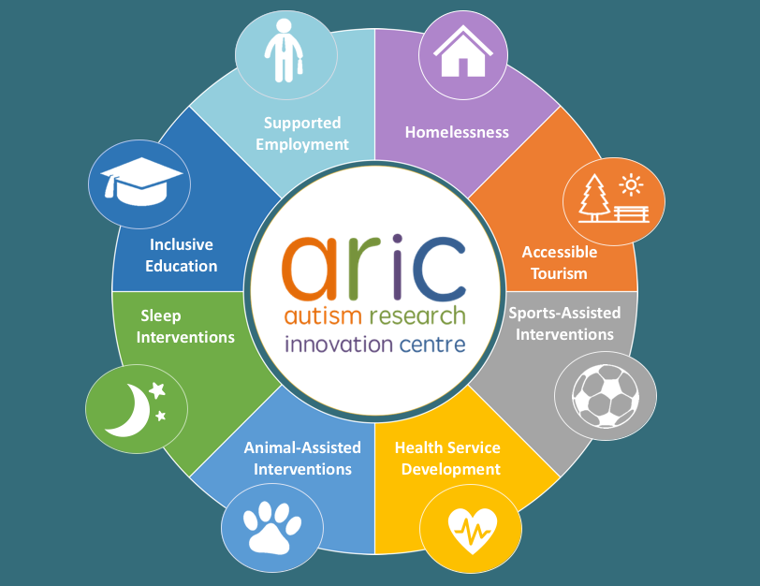
The Autism Research Innovation Centre (ARIC) Niko Kargas

Slide 16
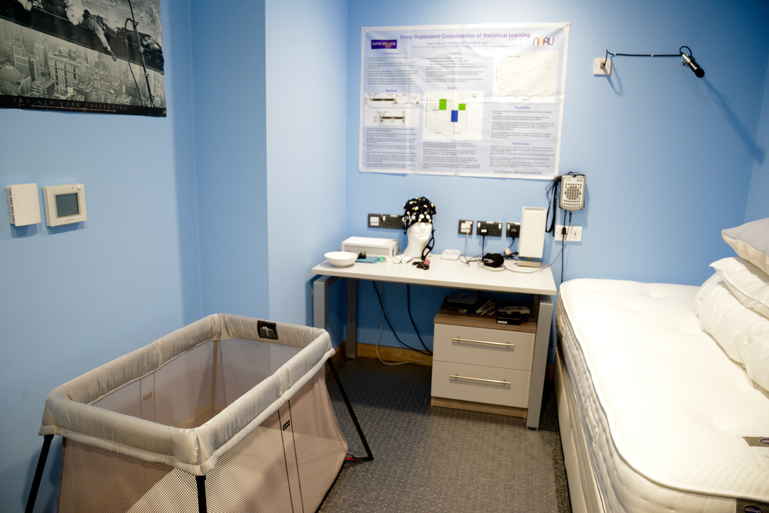
Lincoln Sleep Research Centre (LiSReC)
Outputs published in leading journals such as Sleep Medicine Reviews.
“Neural Entrainment of Brain Rhythms to Aid Sleep” (Simon Durrant and Kirsty Miller; British Academy/Leverhulme Trust).
Consultancy contract for service evaluation of the “Sleep Talkers” project (Simon Durrant and Dave Dawson; The Sleep Charity - £20,000.
Michael Mireku, Caroline Horton and Simon Durrant are currently developing a LiSReC-led project on student sleep with partners at other universities and charities.
Simon Durrant is current Treasurer and Trustee of the British Sleep Society.

Slide 17
IMPACT in the school of psychology
REF 2021 AND BEYOND

Slide 18
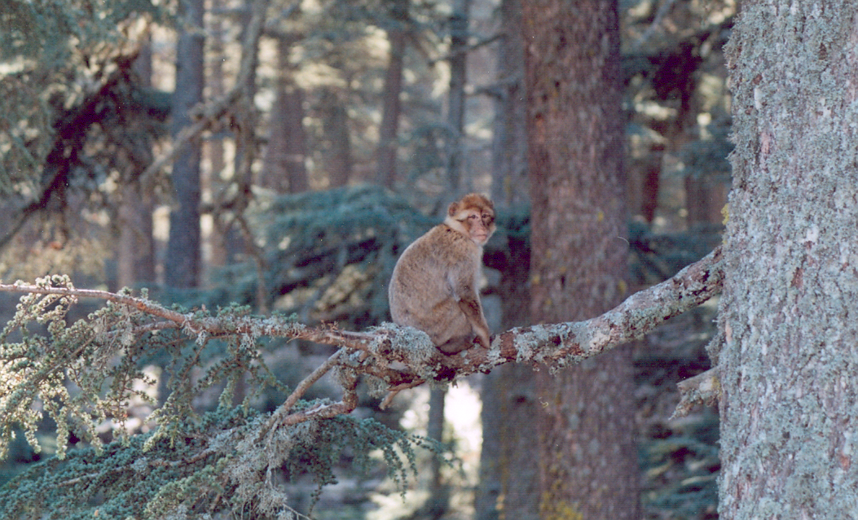
REF 2021 Impact
The Barbary Macaque Project: Applying Psychology to Animal Conservation:
Bonaventura Majolo & Laëtitia Marechal
Research leading to impact
Ecological challenges for macaques.
Benefits of sociality for stress/well-being.
Human-macaque interactions.
Biological conservation.
Human perception of wildlife.
>30 outputs. Papers included in impact case published in: Biology Letters, Proceedings of the National Academy of Sciences, Journal of Personality and Social Psychology, Scientific Reports, Biological Conservation and PeerJ.

Slide 19
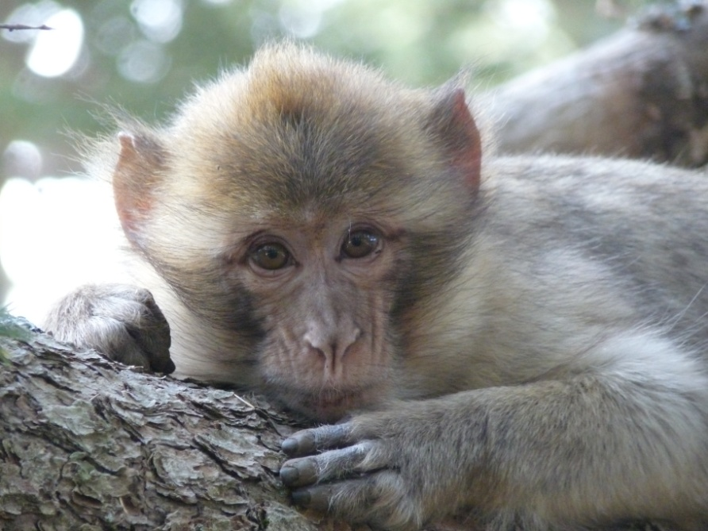
REF 2021 Impact
The Barbary Macaque Project: Applying Psychology to Animal Conservation:
Changed international and national trade laws to upgrade the Barbary macaque protection status (CITES 2016, EU Wildlife Trade legislation 2017).
Designed conservation strategies with Moroccan (Action Plan 2012) and Algerian (Action Plan 2018) governments.
Designed guidelines for the tourist industry on wildlife tourism, now used by over 20 international tourism businesses (e.g. Trip Advisor, Kuoni).

Slide 20
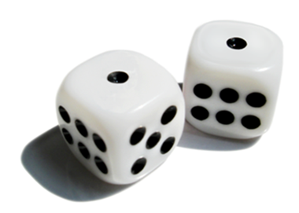
REF 2021 Impact
Harm Minimisation in Digital Gambling:
Amanda Roberts & Adrian Parke
Inpatient residential Treatment since 1971.
Only specifically gambling-focussed residential clinic in the UK.
12 weeks programme- CBT based.
658 male clients over a 15 year period.

Slide 21
Harm Minimisation in Digital Gambling
Suicidal Ideation and Self-harm:

Slide 22
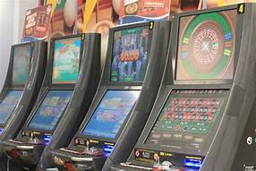
Harm Minimisation in Digital Gambling
Suicide Attempts:

Slide 23
Impact
Harm Minimisation in Digital Gambling:
Trauma, life stressors, violence.
Gambling Commission drew on work.
Legislation changed to reduce minimum stake size.
Gaming Machine (Miscellaneous Amendments and Revocation) Regulations.
Gambling Related Harm All Party Parliamentary Group (GRH APPG).

Slide 24
assessed 361,062 reports
7 in 10 (252,194 reports) confirmed imagery of children being sexually abused
Annual Report, 2021
REF 2021 Impact:
Improving Practitioner Approaches to Online Child Sexual Exploitation Material Offending
Hannah Merdian & Derek Perkins
Ross Bartels, Hannah Bradshaw, David Dawson, Danielle Kettleborough & Nima Moghaddam

Slide 25
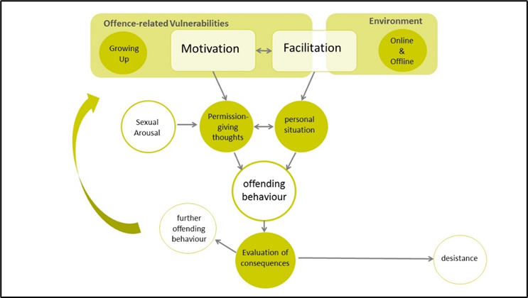
Research leading to impact
Knowledge generation / theory development: pathways to offending, difference to contact offending, thinking patterns.
Development of treatment planning tool.
Feasibility testing of treatment tool.
Worked across all intervention/prevention levels.
Impact
Improved practitioner knowledge and professional practice.
Shaped professional response to CSEM Offending, across sectors and internationally.
Influenced non-statutory/charitable sector > Circles Reboot Programme.
Informed public debate and prevention > Center for Expertise in Child Sexual Abuse.

Slide 26
REF 2027 Impact
The Cognitive Daisy Project : Petra Pollux & John Hudson
Innovative assessment system created to provide healthcare staff with instant snapshot of the cognitive status of older adults.
Improves communication, reduces agitation and enhances person-centred care.
Improves the quality of life in people with dementia living in care homes.

Slide 27
Contact Details
University of Lincoln: School of Psychology
Amanda Roberts: aroberts@lincoln.ac.uk
Hannah Merdian: hmerdian@lincoln.ac.uk
Bonaventura Majolo: bmajolo@lincoln.ac.uk
@arobertslincoln
@OnlineProtect

