Slide 1
Research Groups in the School of Sport & Exercise Science
Dr Hannah Henderson

Slide 2
Physiology
HART
Social Science
Psychology
Biomechanics
School groups & themes
Performance … to do it better
Wellbeing … to make others feel better
Performance
Wellbeing

Slide 3
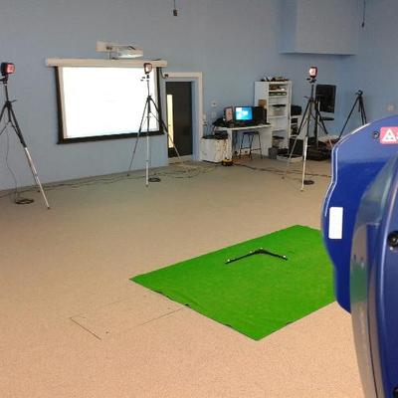
Performance Research Group
BioFeedback Research
Motion Capture Hub
Dr Franky Malloy
Applied Sport & Exercise Physiology
Dr Danny Taylor
Social & Cultural Aspects of Sport, Leisure & Education
Dr Donna Windard
Trampoline design
Police officer body vests
Breathing mechanics & respiratory fatigue in swimming
National level basketballer profiling
Pedagogical research in coaching, school P.E., FE & HE
Social & cultural – emphasis on inequalities & social justice

Slide 4
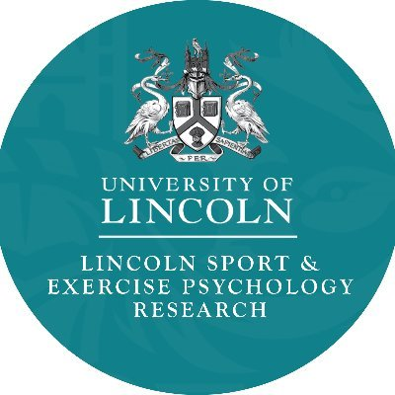
Wellbeing Research Group
Lincoln Sport & Exercise Psychology
Dr Trish Jackman
Health Advancement Research Team
Dr Hannah Henderson
Physical activity through the life course
Development & evaluation of interventions for health
Workplace wellbeing
Goal setting in physical activity
Psycho-social experiences of physical activity
Mental health literacy/ stigma reduction

Slide 5
Future directions…
Group structure
Approach
Funding & collaboration
Develop ECRs
Notes:
Continue to progress

Slide 6
Thanks for listening
@HART_UoL
@LincsSpExPsych
@LincsBiomech
@MoCapHub
@ASEP_Lincoln

